Slide 1
Blood Bank Management System
Presented By:
Bhavya V Kumar
J. Ashwini P. Kanimozhi
V. JudsonSam
I. Shivani
Y. Phanindra

Slide 2
Contents:
Abstract
Existing system
Why we need a new system
System requirements
Proposed system
Advantages of proposed system
List of impacted modules
UML diagrams
Conclusion

Slide 3
Abstract:
Blood Bank Management System (BBMS) is a browser based system that is designed to store, process, retrieve and analyse information concerned with the administrative and inventory management within a blood bank.
This project aims at maintaining all the information pertaining to blood donors, different blood groups available in the blood bank and help them manage in a better way.
Aim is to provide transparency in this field, make the process of obtaining blood from a blood bank hassle free and quickly as possible to make the system of blood bank management effective.
we are stocking blood donors information. The donors who are interested in donating blood has to register in the database.

Slide 4
Existing System:
Existing system of blood bank management is done manually.
All the details including his blood group, medical reports, contact number and other personal details are collected from the donor and it is documented.
All these paper works are stored for future reference.
If an emergency arrives the administrator has to search for the appropriate donor from this huge collection of data

Slide 5
Why We Need A New System
The existing system has the following disadvantages.
It is very time consuming.
It consumes a lot of manpower to better results.
Lack of data security.
It takes a lot of time for the retrieval of data.
The percentage of accuracy is less.
To overcome all these limitations we propose a new system of blood bank management

Slide 6
System Requirements
Software Specifications
Operating System : Windows 8+
Frontend : HTML, CSS, Javascript.
Backend : Core Java
Hardware Specifications
Processor : i3 Processor
RAM : 8GB
ROM : 250GB

Slide 7
Proposed System
The proposed Blood Bank management system helps the people who are in need of a blood by giving them all details of blood group availability or regarding the donors with the same blood group

Slide 8
Advantages of proposed system
The proposed system helps the hospital administration to store the details of blood donors and effectively retrieve it in cases of emergency.
This application saves the time as the Data is retrieved quickly when compared to the existing system where admin have to search for the record manually.
Therefore time management is the main advantage .This application also helps to store the data more accurate and so it is more reliable.
The benefit of this system is the filtering of donors on specific blood groups.
For instance when blood is needed in an emergency and there is very less time to get the blood available so if we get the information like who can give blood in time, so a life is saved.

Slide 9
List Of Impacted Modules
Login Admin Page
Admin Home Page
Add New Donor
Edit and Delete Donor Details
Search Donor By Blood Group

Slide 10
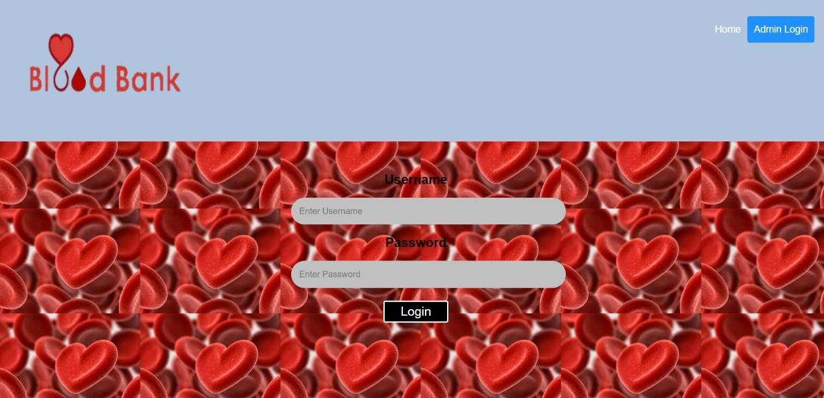
Login Admin Page

Slide 11

Admin Home Page:

Slide 12
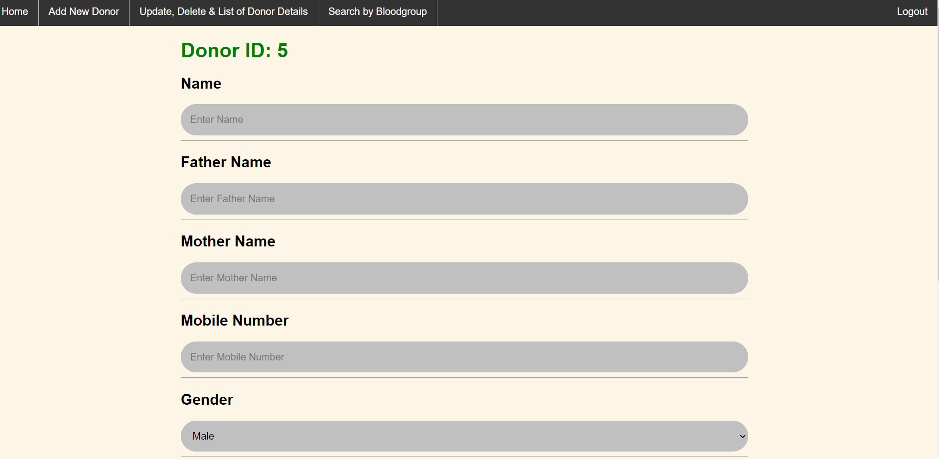
Add new Donor

Slide 13
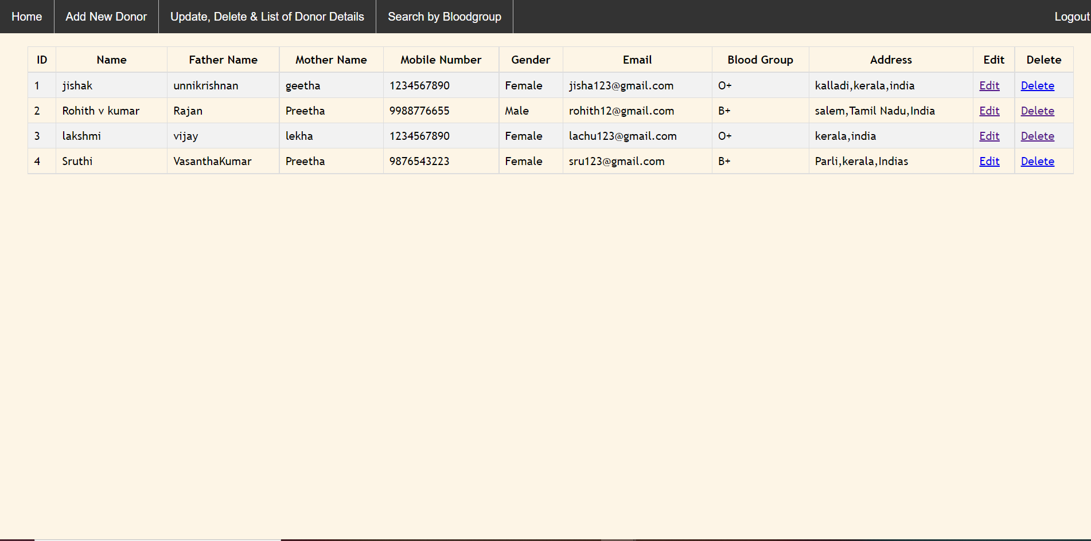
Edit And Delete Donor Details

Slide 14
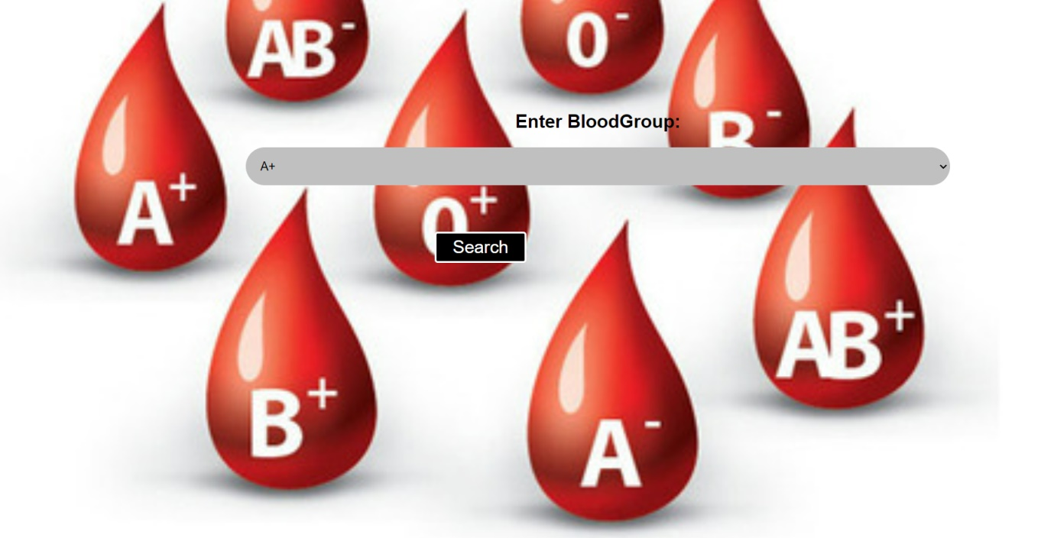
Search Donor By Blood Bank

Slide 15
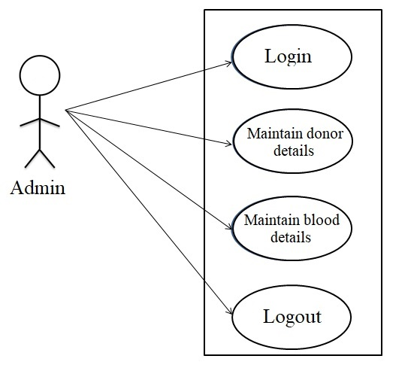
UML Diagram
1.Use Case Diagram

Slide 16
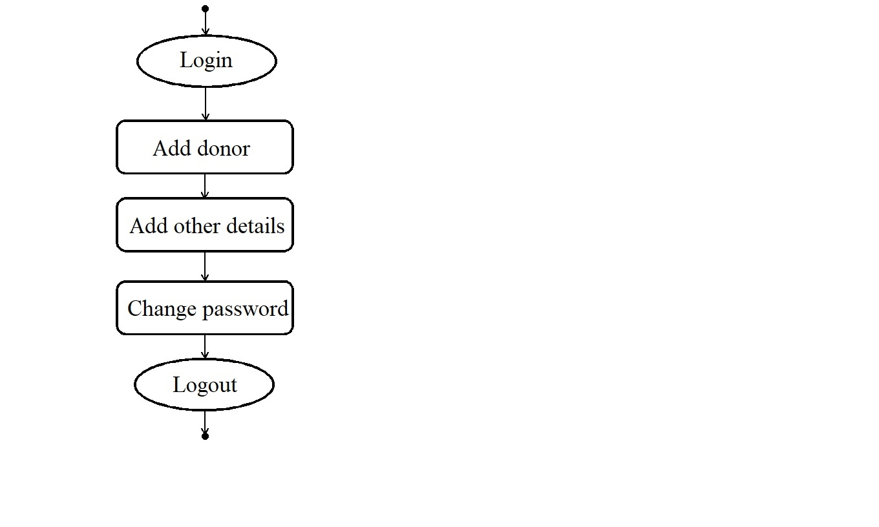
2.Activity Diagram

Slide 17
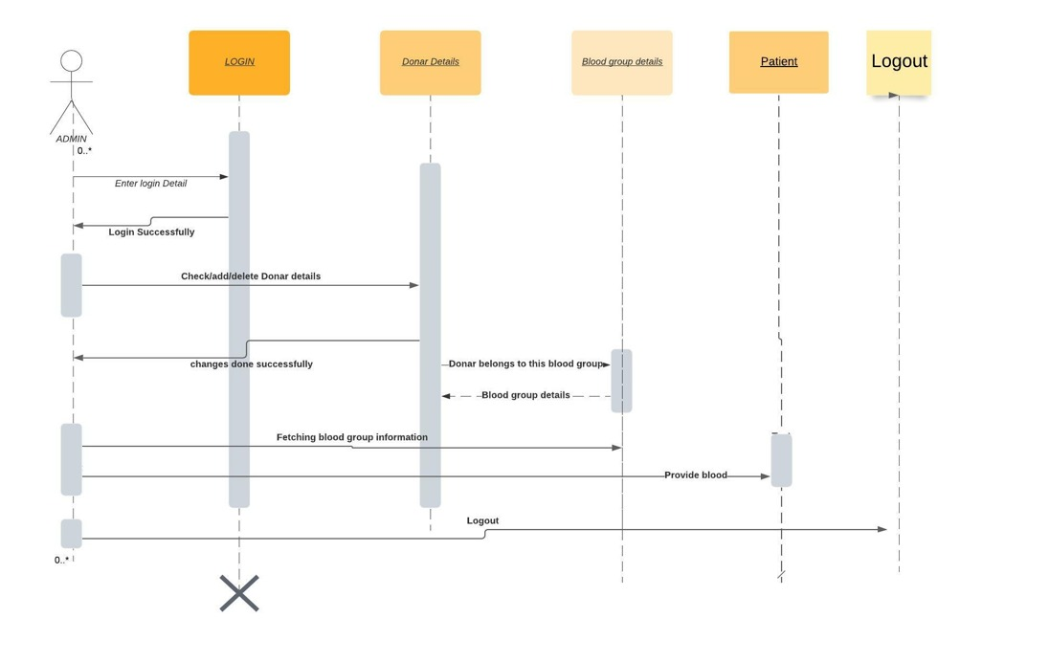
3.Sequence Diagram

Slide 18
Conclusion
Technology is introducing new innovations day by day, thus reducing the time required to do things.
The blood bank management system can be used to reduce the time required to deliver required blood to the needy in cases of emergency.
The web application that we developed can be used by the administrator to search the donors by their blood group in cases of emergencies easily.
The admin can also add, edit, delete or view the donor details using the application.

Slide 19
References:
https://sites.google.com/site/ignoubcafinalyearprojects/project-report/blood-bank-management-system-project-report
http://ignousupport.blogspot.com/p/blood-bank-management-system-project.html
https://www.researchgate.net/publication/339032343_Blood_bank_and_Donor_Management_system
https://www.w3schools.com

Slide 20


